Slide 1
Identify the best source of recruitment for a tech startup, based on previous data candidate sources and recruitment strategies.
By
Vyankatesh kale

Slide 2
Introduction
This assignment aims to give you an idea of applying EDA in a real life business scenario. In this assignment , apart from applying the techniques that you have learnt in EDA module, you will also developed a basic understanding of the best source of recruitment for a tech startup company based on their previous data of candidate sources and recruitment strategies.

Slide 3
problem statement
Identifying the best sources of Recruitment for a tech startup , based on their previous data of candidate sources and recruitment strategies and Identify the best Recruiting sources which has the best performance for the startup.

Slide 4
business objective
This case study aims to identify the best recruiting sources for the tech startup based on the previous data of candidate sources and recruiting strategies. Identify best recruiting source which helps the startup grow.
Visualize the data and draw inferences and make conclusions regarding the quality of the recruiting sources being used

Slide 5
approach
Import the packages
Read the data (Recruiting_data.csv)
Check the null/missing values
Replace null values with ‘Other’
Perform a count on each group using grouping function
Calculate average sales number group by recruiting source
Calculate average attrition number group by recruiting source
Visualize the data using plotnine
Install plotnine and import packages from plotnine
Plot a ggplot using attrition number by recruiting source
Plot a ggplot using sales number by recruiting source
Conclusion

Slide 6
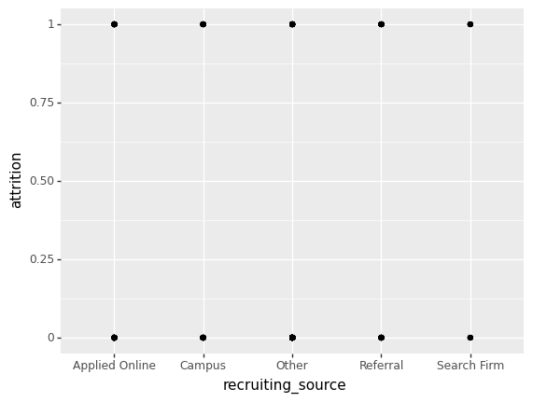
data visualization a ggplot using attrition numbers by the recruiting Source.
Insights from above graph :
1. All recruiting sources have Either attrition 0 or attrition 1

Slide 7
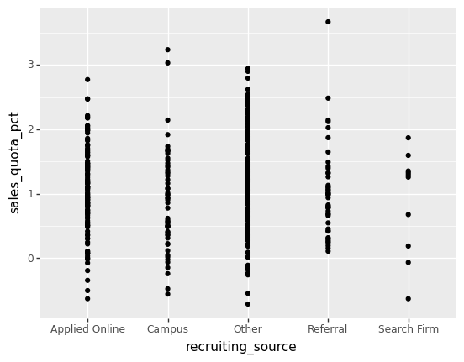
a ggplot using Sales numbers by the Recruiting Source.
Insights from above graph :
1. Performance rating of recruiting sources like Referral and search firm is less than all other sources

Slide 8
conclusion
Recruiting source ‘Other’ has the highest average sales and search firm has least average sales
Search firm has the highest average attrition number
Based on the visualizations Other recruiting source has a best average performance
Search firm has a low performance rating
All recruiting sources have Either attrition 0 or attrition 1
My recommendations on the best recruiting source are 'Campus' and 'referral' because these two having a best performance rating i.e. rating above 3
All recruiting sources does not have performance rating above 3 except 'Campus and Referral'

Slide 9
Thank you

